Slide 1
4. Hardware Design Deployment
Quality Function Deployment (QFD) is a method:
proposed by Dr. Yoji Akao in 1996
to transform qualitative user demands into quantitative parameters
to deploy the functions forming quality
to deploy methods for achieving the design quality into subsystems and component parts,
to specific elements of the manufacturing process.
Notes:
QFD: Phương pháp Triển khai chức năng chất lượng

Slide 2
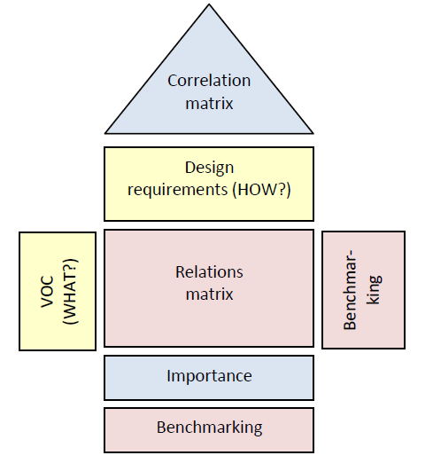
4. Hardware Design Deployment
House of Quality: is a techniques based on QFD
Appeared in 1972
The house can be divided in “rooms”

Slide 3
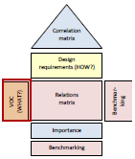
4. Hardware Design Deployment
House of Quality:
Table 1: What?
What is desired in order to reach the new service’s development?
Example: Automatic light control system
No. | Customer’s requirements
1 | Long life cycle
2 | Easy to charge energy
3 | Low power
4 | Low cost

Slide 4
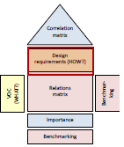
4. Hardware Design Deployment
House of Quality:
Table 2: How list
How are the design requirements of the product?
Example: Automatic light control system
No. | Design requirements
1 | Low power microcontroller
2 | LED light bulb
3 | Solar panel
4 | Lithium-ion battery

Slide 5
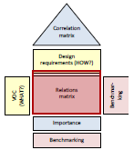
4. Hardware Design Deployment
House of Quality:
Table 3: Relation matrix
shows the relationships between “What” and “How”
defined by three strength levels: weak, medium, and strong relation.
Design requirement Customer’s requirement | Low power micro-controller | LED light bulb | Solar panel | Lithium-ion battery
Long life cycle | S | S | S | S
Easy to charge energy | W | W | S | M
Low power | M | S | W | M
Low cost | M | M | M | S

Slide 6
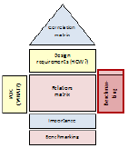
4. Hardware Design Deployment
House of Quality:
Table 4: Benchmarking
Benchmarking is carried out for “What” and “How”.
Persons in charge of the product design make this evaluation
Design requirement Customer’s requirement | Low power micro-controller | LED light bulb | Solar panel | Lithium-ion battery | Evaluator 1 | Evaluator 2 | Evaluator 3
 |  |  |  |  | Bad | Average | Good
Long life cycle | S | S | S | S |  |  | X
Easy to charge energy | W | W | S | M |  | X
Low power | M | S | W | M |  | X
Low cost | M | M | M | S |  | X

Slide 7
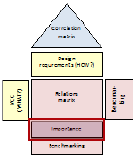
4. Hardware Design Deployment
House of Quality:
Table 5: Importance level
Create a value for each relationship between client and design requirement
The personnel in charge of the system design make this evaluation.

Slide 8
4. Hardware Design Deployment
House of Quality:
Table 5: Importance level
Design requirement Customer’s requirement |  | Low power micro-controller | LED light bulb | Solar panel | Lithium-ion battery | Evaluator 1 | Evaluator 2 | Evaluator 3
What | Importance |  |  |  |  | Bad | Average | Good
Long life cycle | 4 | S | S | S | S |  |  | X
Easy to charge energy | 1 | W | W | S | M |  | X
Low power | 2 | M | S | W | M |  | X
Low cost | 3 | M | M | M | S |  | X
Importance |  | 52 | 64
Strong = 9 Medium = 3 Weak = 1

Slide 9
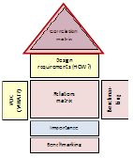
4. Hardware Design Deployment
House of Quality:
Table 6: Correlation matrix
is a triangular table.
describes the strength of the relationships between the design requirements.
is to identify which requirements support each other and which ones do not.

Slide 10
Hardware Design Deployment
House of Quality:
Table 6: Correlation matrix
++ Strong positive
+ positive
- negative
+
+
++
Low power micro-controller | LED light bulb | Solar panel | Lithium-ion battery

